Slide 1

C
H
S
E
S
F
N
E
Aaron debebe
Constantin Schreyer

Slide 2
Gliederung
Unsere Idee im Detail
Businessplan
Umsetzungsstrategie und aktueller Stand
Via Fine-tuned LLM
Via Chess Engine LLM

Slide 3

Unsere Idee im detail
Oct 20XX
Roll out product to local schools to establish new STEM curriculum
Feb 20XX
Release to regional school districts and monitor trends in each school
May 20XX
Gather feedback from teachers and continue to expand availability of the product

Slide 4
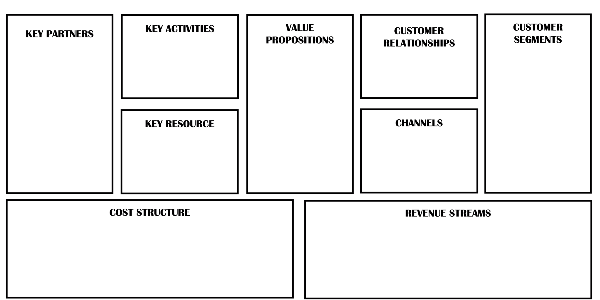
Businessplan
-
-
-
-
-
-
-
-
-

Slide 5

Umsetzungsstrategie und aktueller Stand - Via fine-tuned llm
$3B
$2B
$1B
Opportunity to build
Fully inclusive market
Total addressable market
Freedom to invent
Selectively inclusive market
Serviceable available market
Few competitors
Specifically targeted market
Serviceable obtainable market

Slide 6



Umsetzungsstrategie und aktueller Stand - Via fine-tuned llm
Research
Abstract
Design
We based our research on market trends and data from over 1,000 schools
We believe students need new study materials to help them succeed
Study tools are easy to use and accessible for all demographics

Slide 8
Unsere idee im detail
Market gap
Customers
Financials
Schools need to implement STEM curriculum but are using old or outdated books or educational materials
10% increase from college recruitment that focus on STEM classes
STEM students received over $2 million dollars in grants
Costs
usability
Design
Lack of strong STEM education can remove students from the running when it comes to college recruitment
Schools want something that’s easy to adopt and simple to use for their students
Current study tools are hard to use and inaccessible for some demographics

Slide 9

Product overview
Unique
Only curriculum specifically dedicated to helping both schools and students
First to market
First beautifully designed tool that's both stylish and focused on STEM education
Authentic
Designed with the help and input of students and teachers in STEM field

Slide 10

Product benefits
Simple and efficient to use
Quick customer service assistance
Free 90-day customer support

Slide 11

Company overview
S
T
E
M

Slide 12
Business model
Research
Abstract
Design
We based our research on market trends and data from over 1,000 schools
We believe students need new study materials to help them succeed
Study tools are easy to use and accessible for all demographics

Slide 13
Market overview
$3B
$2B
$1B
Opportunity to build
Fully inclusive market
Total addressable market
Freedom to invent
Selectively inclusive market
Serviceable available market
Few competitors
Specifically targeted market
Serviceable obtainable market

Slide 14
Market comparison
3
billion
Opportunity to build
Addressable market
2
billion
Freedom to invent
Serviceable market
1
billion
Few competitors
Addressable market

Slide 15
Our competition
Contoso
Competitors
Our curriculum is priced below that of other tools in the education market
Simple and easy to use, compared to the complex tools of the competitors
Affordability is the main draw for educators to adopt our products
Company A Product is more expensive
Companies B & C Product is expensive and inconvenient to use
Companies D & E Product is affordable, but inconvenient to use

Slide 16
Our competition
Convenient
Contoso Ltd.
Competitor A
affordable
Expensive
Competitor C
Competitor E
Competitor D
Competitor B
Inconvenient

Slide 17
SCALING FOR the future
Feb 20XX
Roll out product to local schools to establish new STEM curriculum
May 20XX
Release to regional school districts and monitor trends in each school
Oct 20XX
Gather feedback from teachers and continue to expand availability of the product

Slide 18
Two-year action plan
Draft blueprints
Gather feedback
Deliver to students
20XX
JAN
FEB
Mar
Apr
May
Jun
Jul
AUG
SEP
Oct
Nov
Dec
20XX
Jan
Feb
Mar
Apr
May
Jun
Jul
Aug
SEP
Oct
Nov
Dec
Run focus groups
Test with schools
Regional launch
July, 20XX

Slide 19
Financials
 | YEAR 1 | YEAR 2 | YEAR 3
INCOME
Users | 50,000 | 400,000 | 1,600,000
Sales | 500,000 | 4,000,000 | 16,000,000
Average price per sale | 75 | 80 | 90
Revenue @ 15% | 5,625,000 | 48,000,000 | 216,000,000
Gross profit | 5,625,000 | 48,000,000 | 216,000,000
EXPENSES
Sales & marketing | 5,062,500 | 38,400,000 | 151,200,000 | 70%
Customer service | 1,687,500 | 9,600,000 | 21,600,000 | 10%
Product development | 562,500 | 2,400,000 | 10,800,000 | 5%
Research | 281,250 | 2,400,000 | 4,320,000 | 2%
Total expenses | 7,593,750 | 52,800,000 | 187,920,000

Slide 20




Meet the team
Takuma Hayashi​
Mirjam Nilsson​
Flora Berggren​
Rajesh Santoshi​
President
Chief Executive Officer
Chief Operations Officer
VP Marketing

Slide 21








Meet the FULL team
Takuma Hayashi
Flora Berggren​
Graham Barnes
Elizabeth Moore
President
Chief Operations Officer
VP Product
Product Designer
Mirjam Nilsson​
Rajesh Santoshi​
Rowan Murphy
Robin Kline
Chief Executive Officer
VP Marketing
SEO Strategist
Content Developer

Slide 22

Summary
At Contoso, we believe in giving 110%. By expanding STEM education tools, we help schools build a curriculum that will aid student success in college. We thrive because of our market knowledge and a great team behind our curriculum. As our CEO says, "Efficiencies will come from proactively transforming how we do business."

Slide 23


Thank you
Mirjam Nilsson​
mirjam@contoso.com
www.contoso.com
206-555-0146

